Slide 1


Wordex: Screens and identifies dyslexia types, offering an interactive platform for targeted improvement.
R24-25J-229

Slide 2

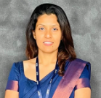
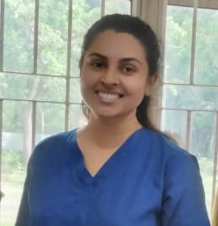

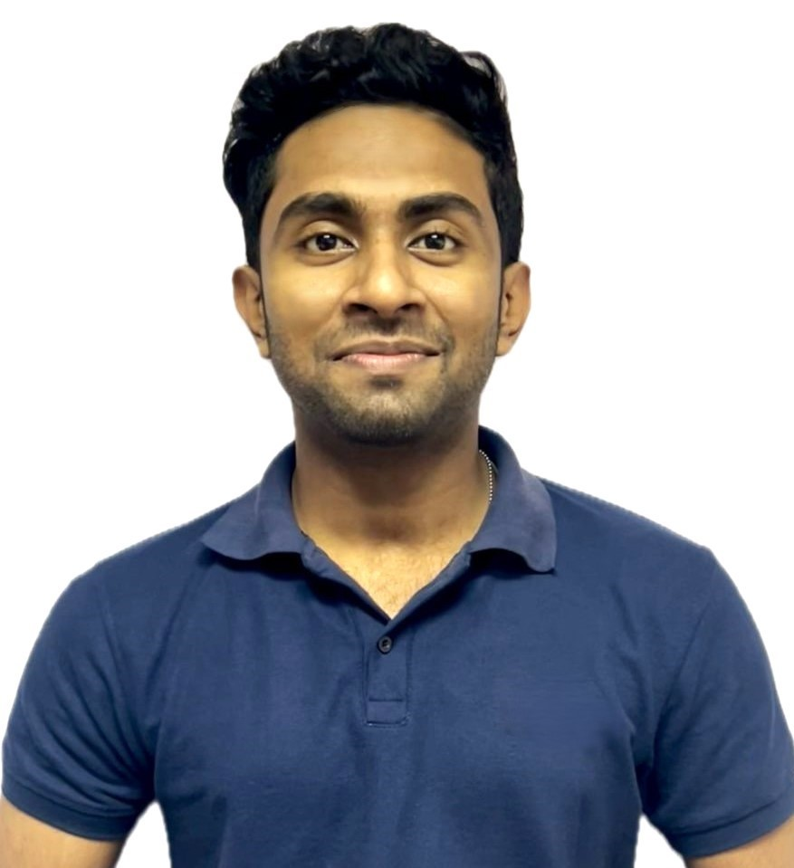

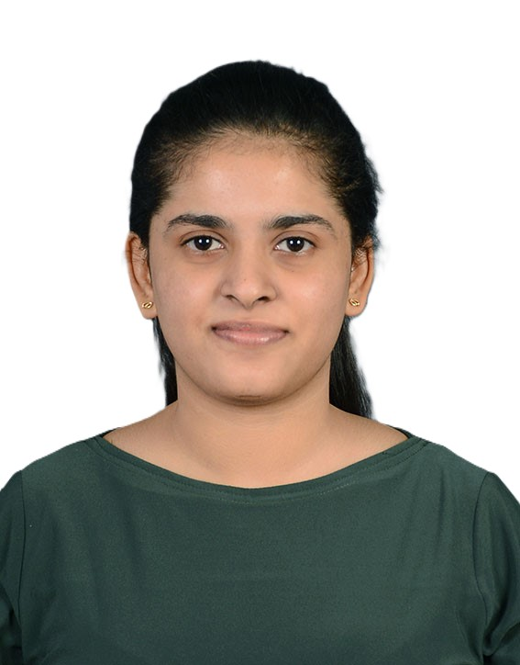

OUR TEAM
Supervisor
Co - Supervisor
External Supervisor
External Supervisor
Prof. Samantha Thelijjagoda
Ms. Poojani Gunathilake
Dr. Shamini Dissanayake
Ms. Kalpani Abeysinghe
Group Leader
Dissanayake D.M.O.W.
Samarakoon S.M.S.C.
Madushan J.G.N.
Hansamal G.P.S.

Slide 3
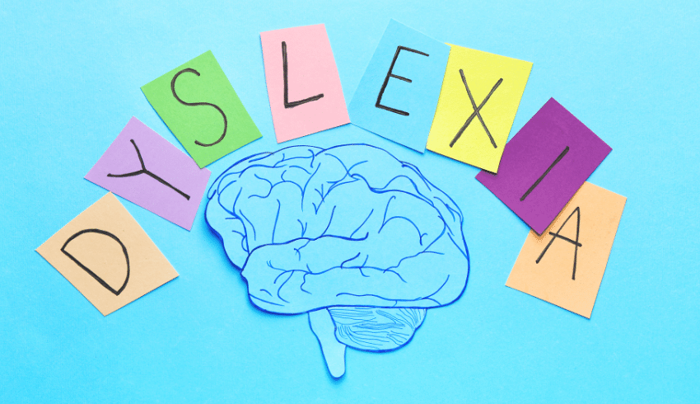
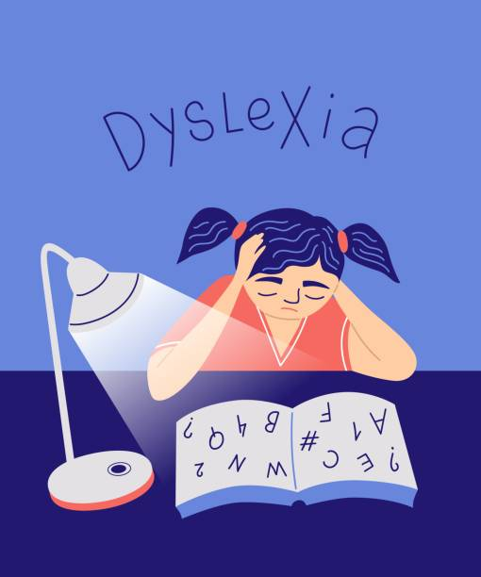
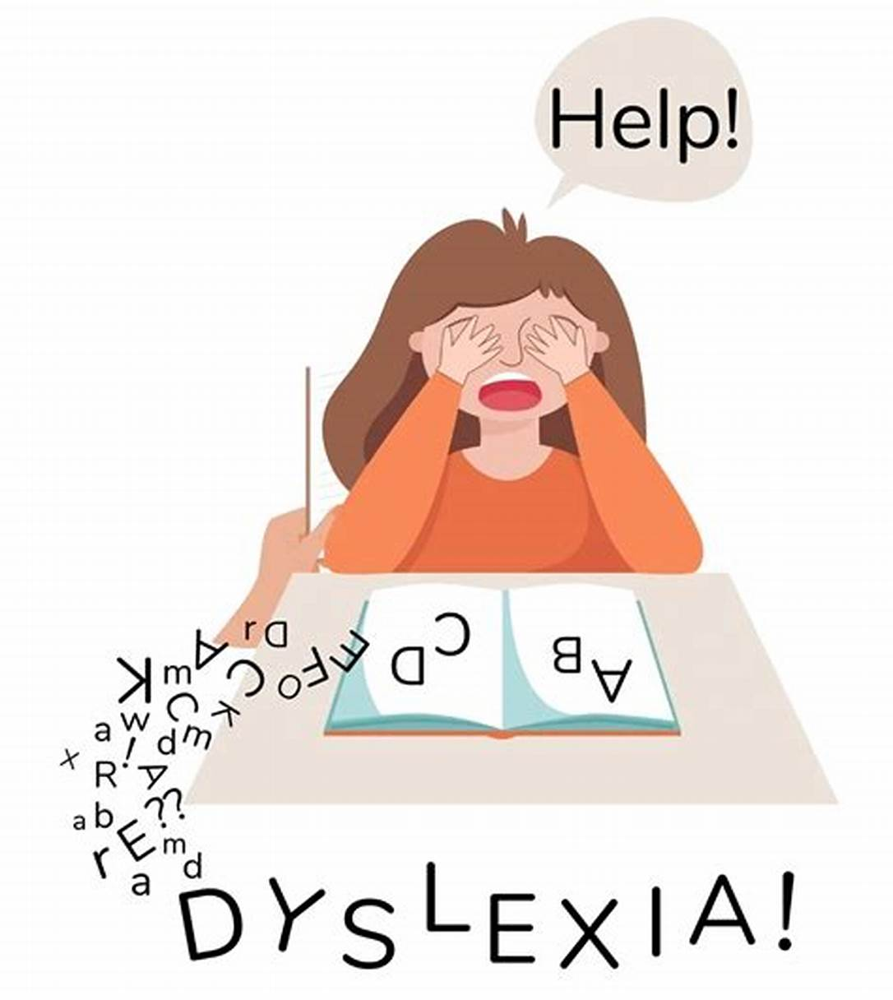
WHAT IS DYSLEXIA?
Dyslexia is a learning difficulty that primarily affects the skills involved in accurate and fluent word reading and spelling.
Dyslexia is a learning difficulty that primarily affects the skills involved in accurate and fluent word reading and spelling.

Slide 4
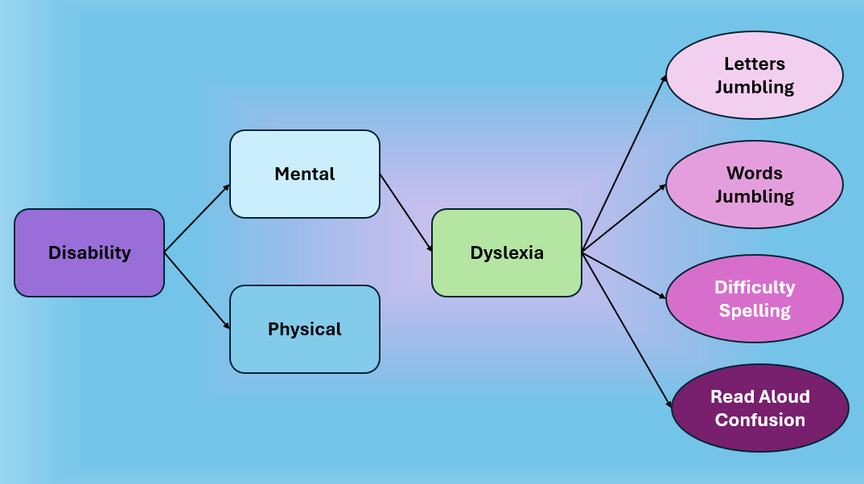
INTRODUCTION

Slide 5

INTRODUCTION CONT.
Related to Primary education.
A very common learning disability.
About 5-10% of the entire population is affected.
(DyslexicHelp.org, 2024).
About 15%-20% of primary students are affected. (crossrivertherapy.com, 2025).
Difficulty in different areas of primary languages.
[1] DyslexicHelp.org, “What is dyslexia?,” DyslexicHelp.org, 2024. [Online]. Available: https://dyslexichelp.org. [Accessed: May 25, 2025].
[2] CrossRiverTherapy.com, “Dyslexia statistics,” CrossRiverTherapy.com, 2024. [Online]. Available: https://crossrivertherapy.com. [Accessed: May 25, 2025].

Slide 6
RESEARCH QUESTION
That screens and identifies the risk of different types of Dyslexia in students aged 8-10?
How to develop a mobile application
Provides interactive and comprehensive activities to reduce the affect of Dyslexia?

Slide 7


What Is Wordex?
Wordex is a mobile application that offers medically approved quizzes for children to assess their type of dyslexia whether positive or not and then helps them overcome it through interactive games

Slide 8
SOLUTION OVERVIEW
A system that detects risk of 4 main types of Dyslexia.​
For students between ages 8-10
Supports Font English
All remedial activities are developed in line with actual school syllabuses

Slide 9
OBJECTIVES
Assist Primary school students suffering from Dyslexia in a new and interactive way by,
Identifying the specific type of Dyslexia, they suffer from
Providing relevant activities to improve their weak points
Making learning Languages more accessible and enjoyable experience for all students.

Slide 10
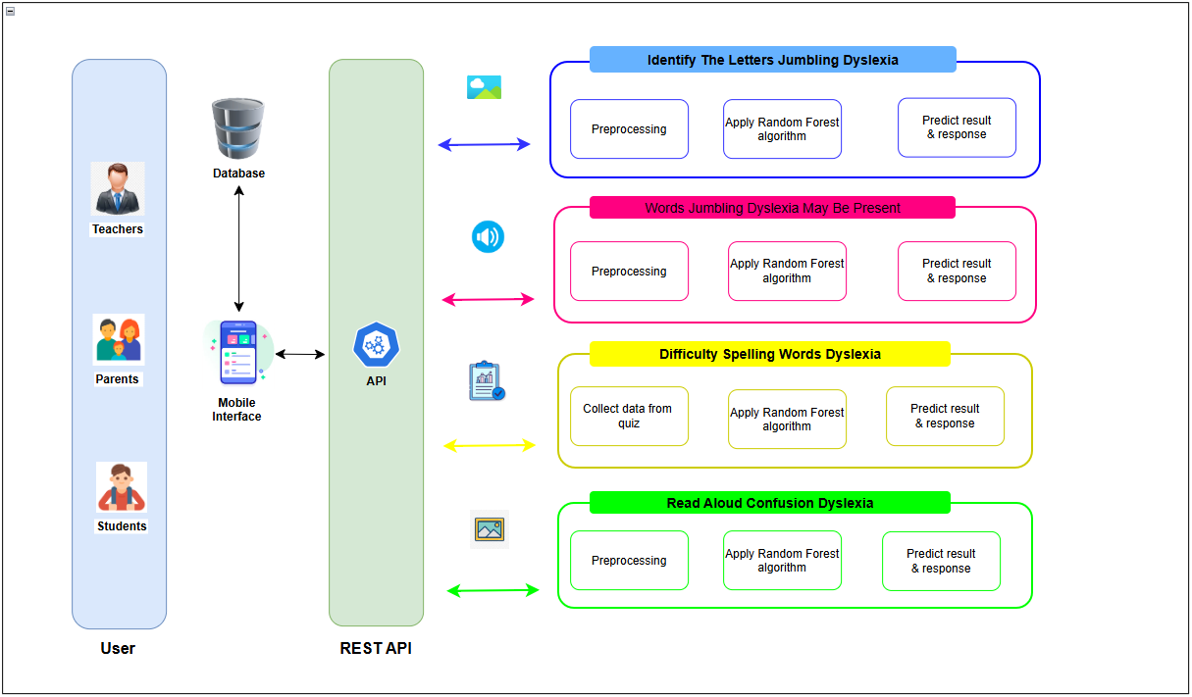
SYSTEM DIAGRAM

Slide 11
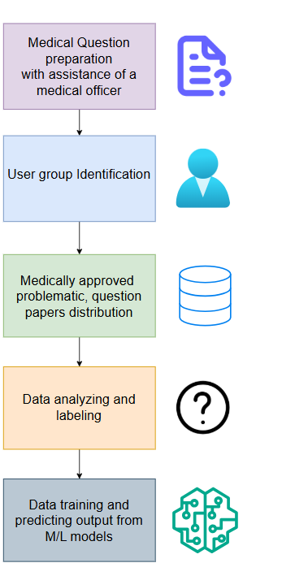
HOW WE
GATHERED DATA

Slide 12
PROGRESS COMPARISON
PP1 - Medical & AI Research | PP2 - Mobile App Development & AI Integration | Project End
Medical officer and school visits | Research paper creation | Enhanced UI/UX
Medical question preparation | Front-end creation | Production Website Creation For Wordex
Data gathering and analysis | Databases Integration | Embedded learning quizzes
Data classification | Question and IQ test integration into a mobile app | Successful Creation of Wordex Mobile App
Learning model creation | Voice and writing recognition integration into a mobile app
Output results prediction
Athukorala K.A.D.P.S it21045912

Slide 13






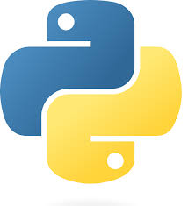
Technologies
Python

Slide 14
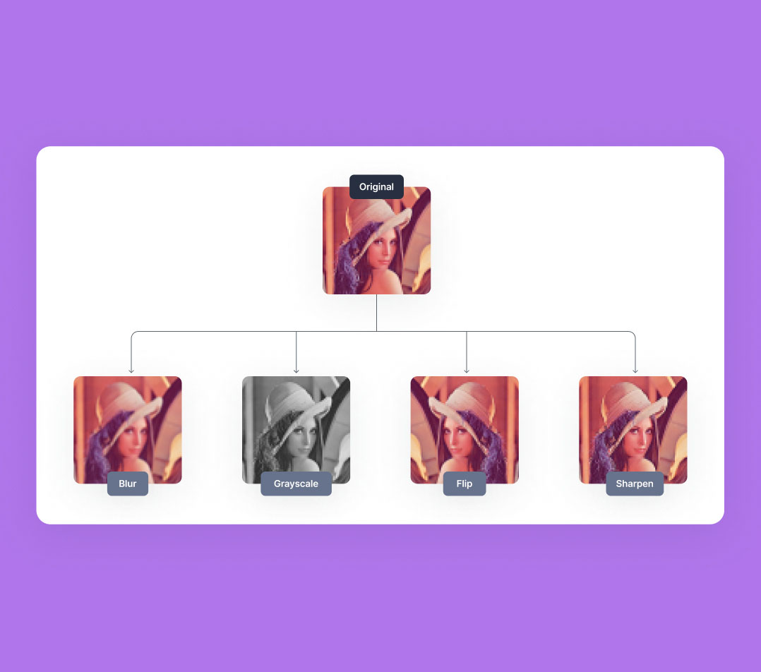


KEY PILLARS
Voice recognition and matching
Machine Learning​
Supervised Learning​
Interactive activity development​
Progress Tracking
IT21008764 | Hansamal GPS

Slide 15
Literature review & problem definition
Challenges in Dyslexia Identification
Difficulty in early diagnosis due to varying symptoms.
Lack of standardized assessment tools across different age groups.
Limited awareness among educators and parents.
Technological Solutions for Dyslexia Screening
Use of AI-based tools for automated reading assessments.
Writing recognize and analyze patterns.
Speech recognition systems to detect phonological processing issues.
Enhancing Learning for Dyslexic Individuals
Development of adaptive learning platforms tailored for dyslexic students.
Gamification techniques to improve engagement and retention.
Use of assistive technologies such as text-to-speech and audiobooks.
IT21008764 | Hansamal GPS

Slide 16
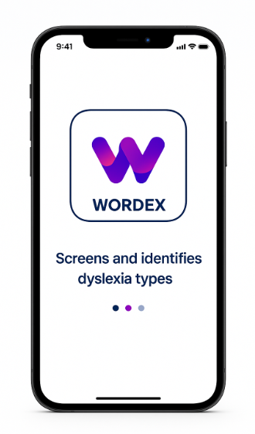
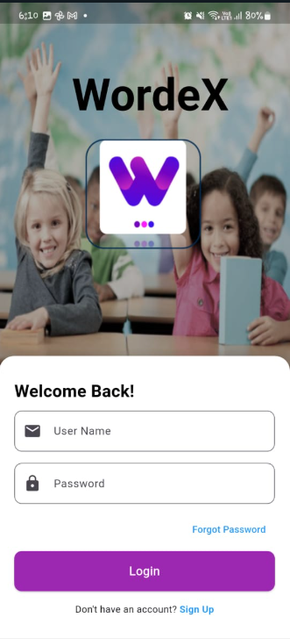
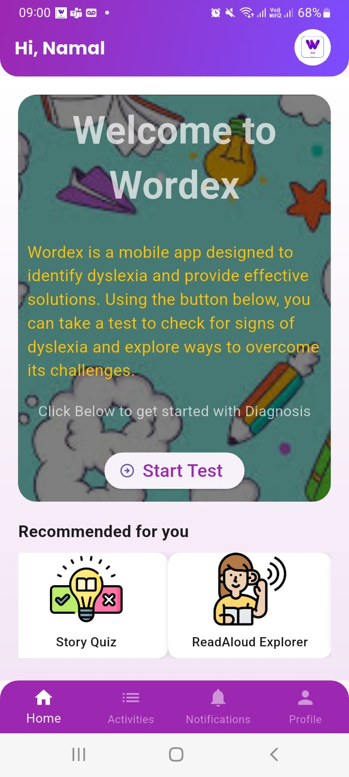
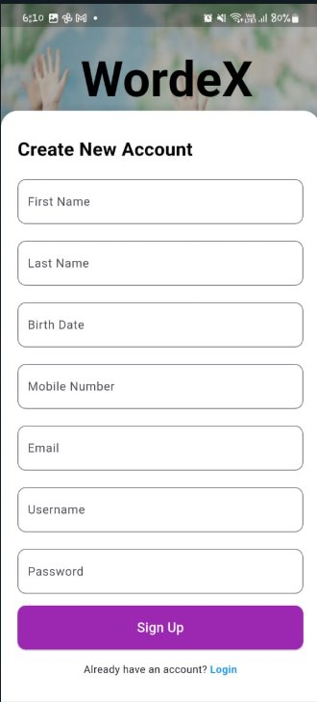
Wordex App

Slide 17
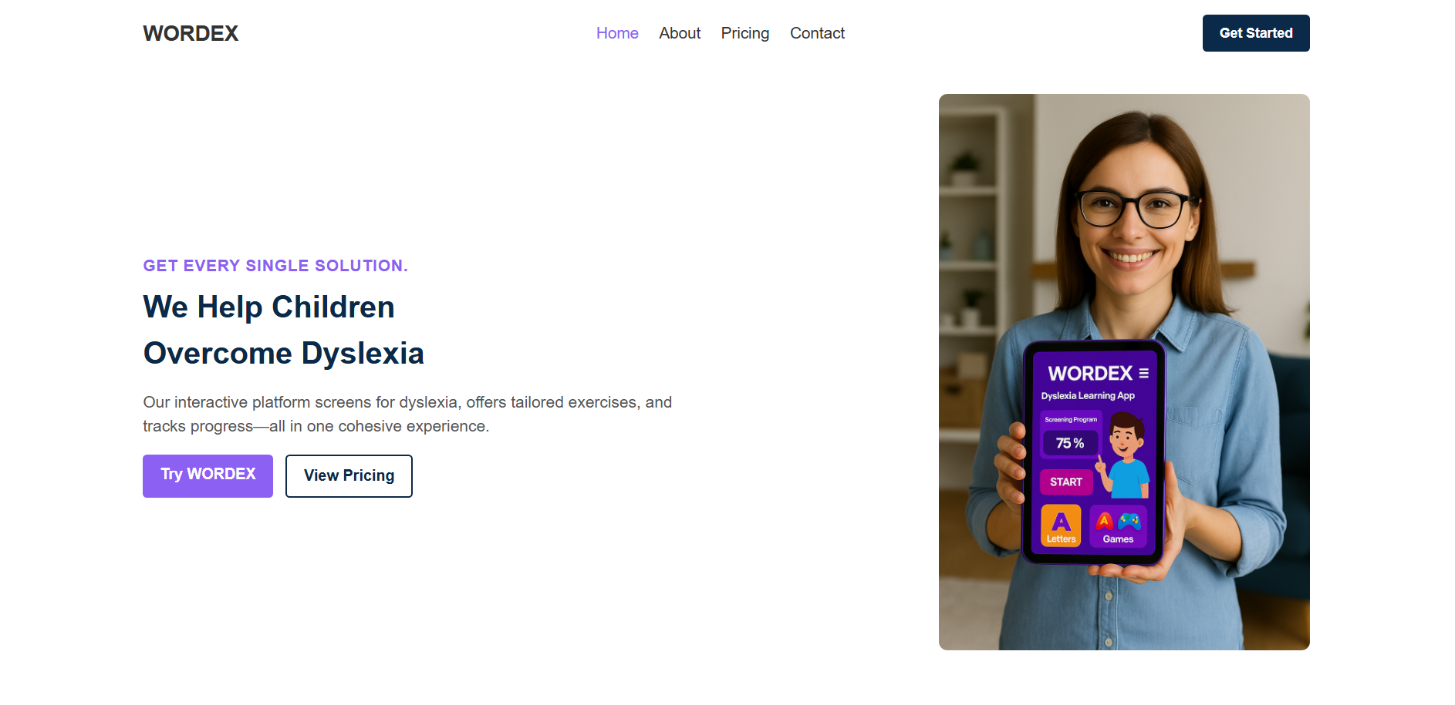
Wordex Production Website

Slide 18
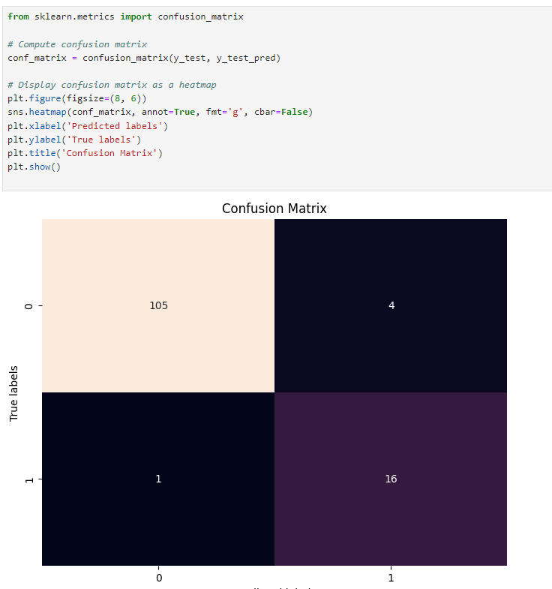
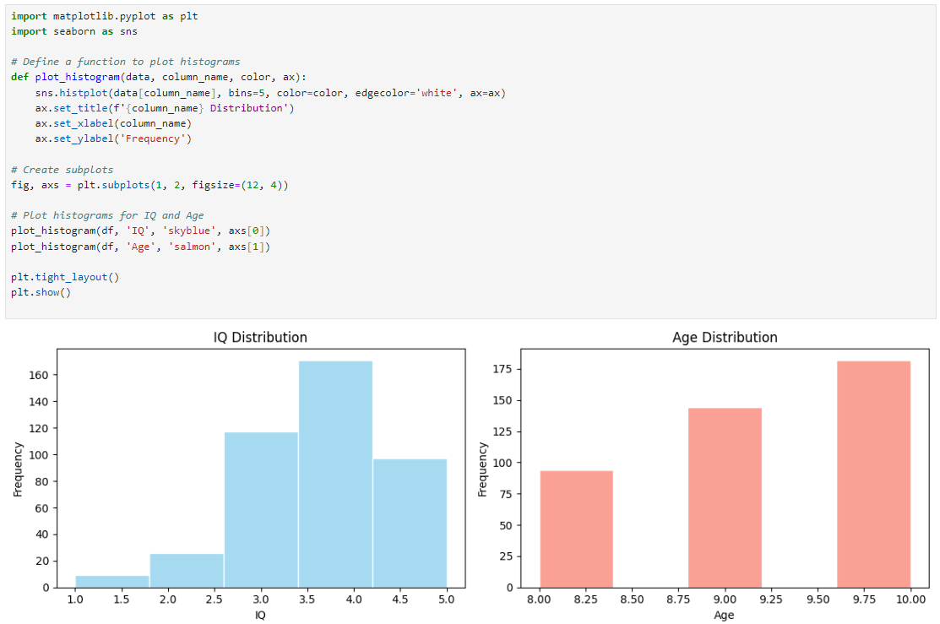
ACHEIVEMENTS – DATA TRAINING AND ACCURACY
IT21008764 | Hansamal GPS

Slide 19
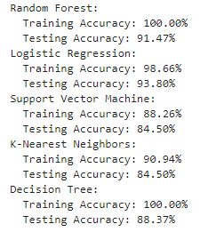
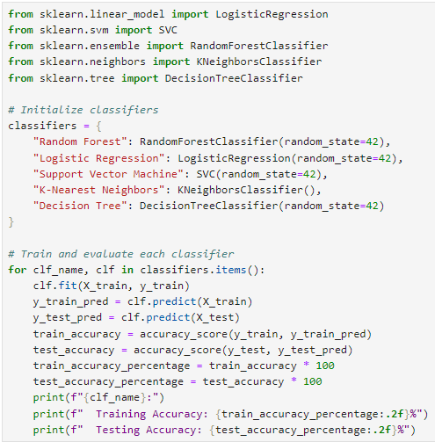
ACHEIVEMENTS – DATA TRAINING AND ACCURACY
IT21008764 | Hansamal GPS

Slide 20
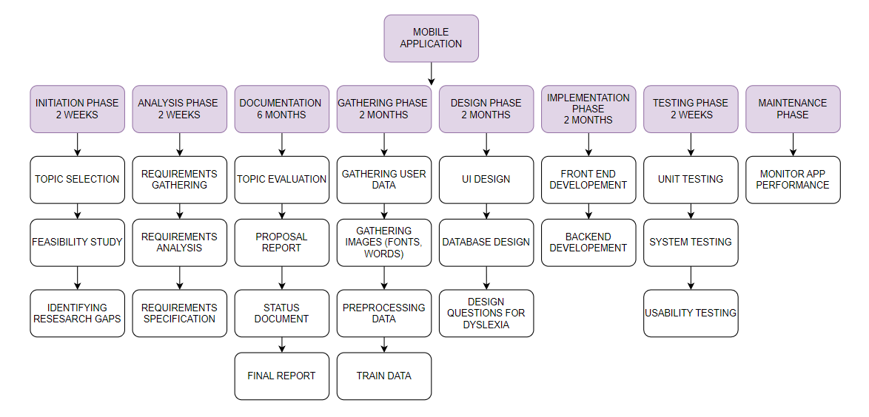
WORK BREAKDOWN STRUCTURE
IT21008764 | Hansamal GPS

Slide 21
IT21008764 | G.P.S HANSAMAL
BSc (Hons) Degree in Information Technology
Identify Letters Jumbling Dyslexia (Surface Dyslexia)
IT21008764 | Hansamal GPS

Slide 22
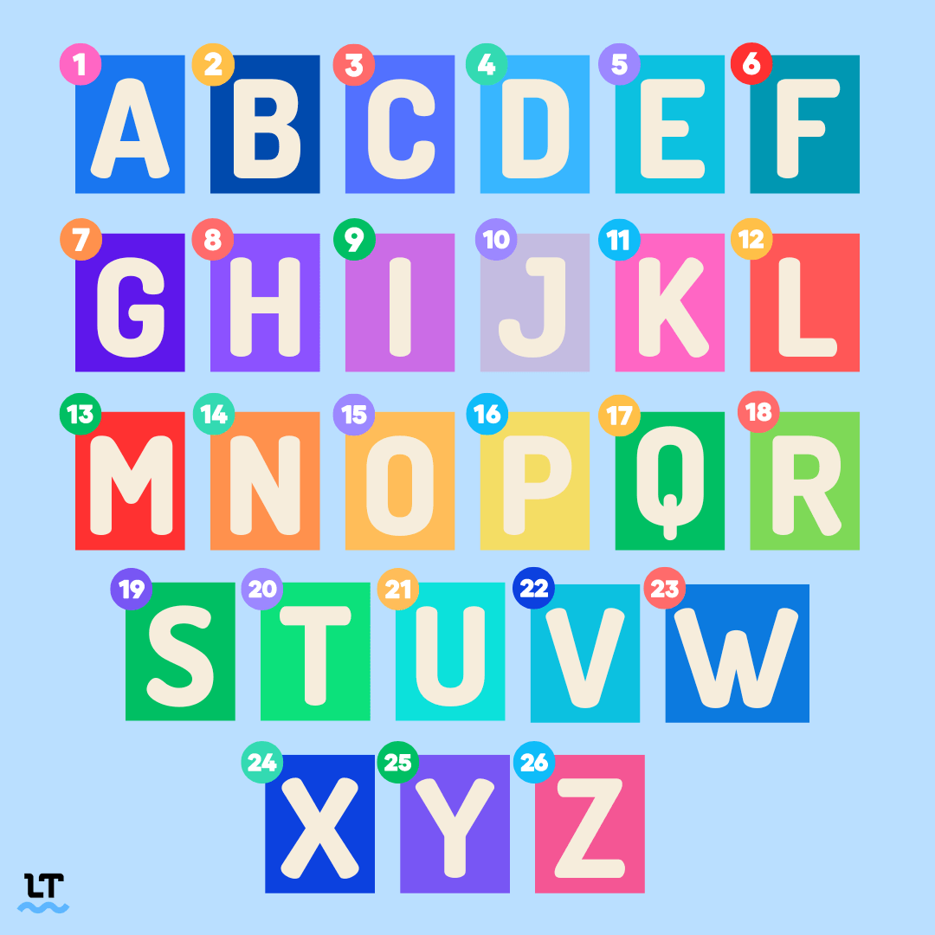

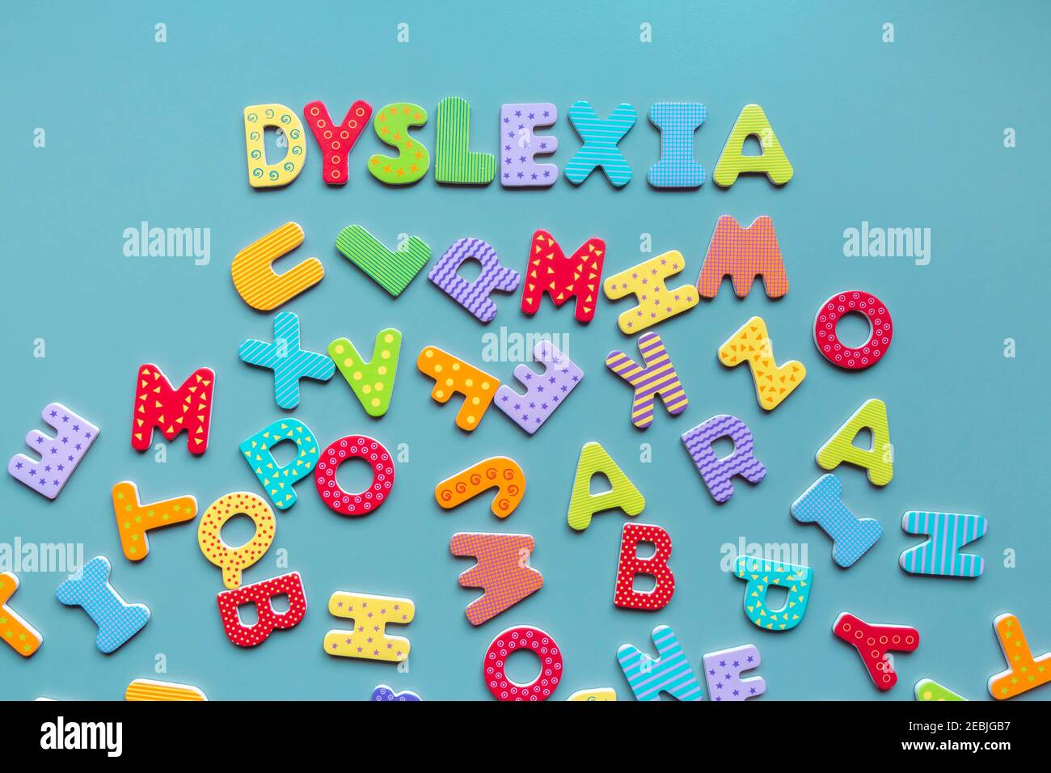
BACKGROUND
Definition:
Letters Jumbling Dyslexia is a type of dyslexia characterized by difficulties in recognizing atomic level of letters.
Challenges:
Significantly impacts a child's ability to read, write, and understand letters accurately.
Impact:
Early detection and targeted intervention are crucial for mitigating the adverse effects on academic performance and self-esteem.
IT21008764 | Hansamal GPS

Slide 23
OBJECTIVES
Specific Objective​​
To identify the risk of Letters Jumbling dyslexia and develop interactive activities to eliminate the risk.​​
Sub Objectives
To identify the risk of Develop interactive activities to eliminate the risk of each type.
Generate reports for parents and keep track of progress.
IT21008764 | Hansamal GPS

Slide 24
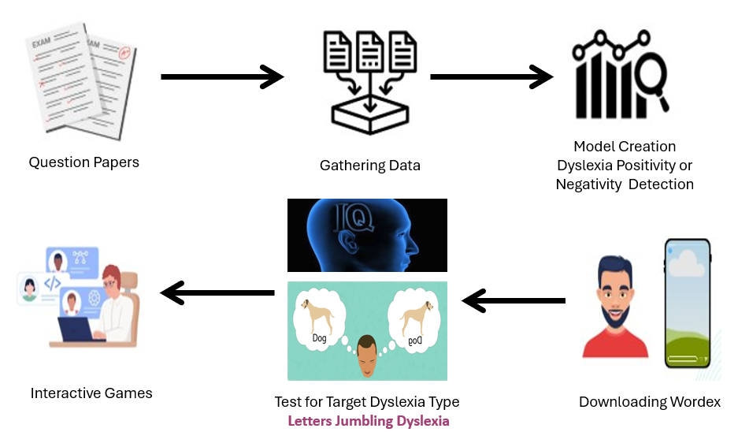
COMPONENT DIAGRAM

Slide 25
FUNCTIONAL REQUIREMENTS
User Login and General IQ test
Set to IQ test results into an algorithm
Screening for the risk of Dyslexia Type
Providing Remedial activities for Dyslexia type
IT21008764 | Hansamal GPS

Slide 26
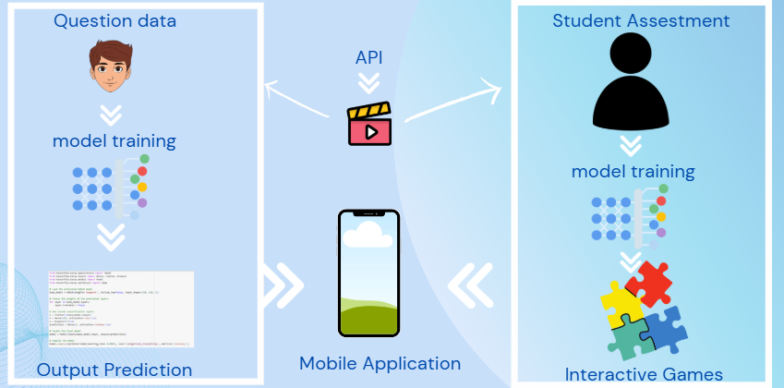
IMPLEMENTATION
Question Data
Student Assessment
API
Model Training
Model Training
Mobile Application
Output Prediction
Interactive Games

Slide 27
REFERENCES
C. Kariyawasam, M. Nadeeshani, T. Hamid, I. Subasinghe, and P. Ratnayake, "A Gamified Approach for Screening and Intervention of Dyslexia, Dysgraphia and Dyscalculia," presented at the 2019 International Conference on Advancements in Computing (ICAC), Malabe, Sri Lanka, Dec. 5-7, 2019. DOI: 10.1109/ICAC49085.2019.9103336.
A. Author, "ALEXZA: A Mobile Application For Dyslexics," vol. 10, no. 1, pp. 25-35, 2024.
B. Author, "Nana Shilpa - A Mobile-Based Screening and Refinement System to Identify the Risk of Dyslexia and Dysgraphia Learning Disabilities in Primary School Students," pp. 50-60, 2024.
Nessy Learning, "Nezzy Learning," [Online]. Available: https://www.nessy.com/en-gb. [Accessed: Aug. 5, 2024]. Available: Nessy Learning
C. Author, "A Gamified Approach for Screening and Intervention of Dyslexia, Dysgraphia and Dyscalculia," vol. 15, no. 3, pp. 100-110, 2024.
Tests for Dyslexia and Learning Disabilities | Dyslexia Help at the University of Michigan. Available: Dyslexia Help - University of Michigan
IT21008764 | Hansamal GPS

Slide 28
IT21345128 D.M.O.W DISSANAYAKE
BSc (Hons) Degree in Information Technology
Identify That Words Jumbling Dyslexia May Be Present And Provide Activities To Reduce The Risk.
IT21345128 | Dissanayake D.M.O.W

Slide 29
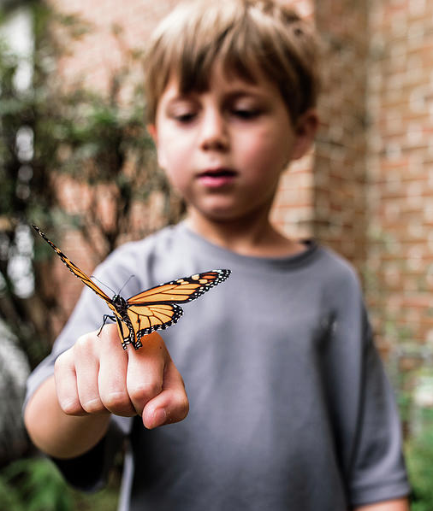
BACKGROUND
Definition:
Whole Word Jumbling Dyslexia is characterized by difficulties in recognizing and processing whole words correctly.
Individuals often jumble letters within words, making it hard to read and understand text accurately.
Challenges:
Leads to significant challenges in reading fluency and comprehension.
Impact:
Early detection and targeted intervention are crucial for helping individuals improve their reading skills and academic performance.
Hmm...
A Flutterby??
IT21345128 | Dissanayake D.M.O.W

Slide 30

RESEARCH QUESTIONS
How can a mobile application effectively screen for Whole Word Jumbling Dyslexia in children aged 8-10 and provide personalized interventions to improve their reading & writing skills?
​
IT21345128 | Dissanayake D.M.O.W

Slide 31
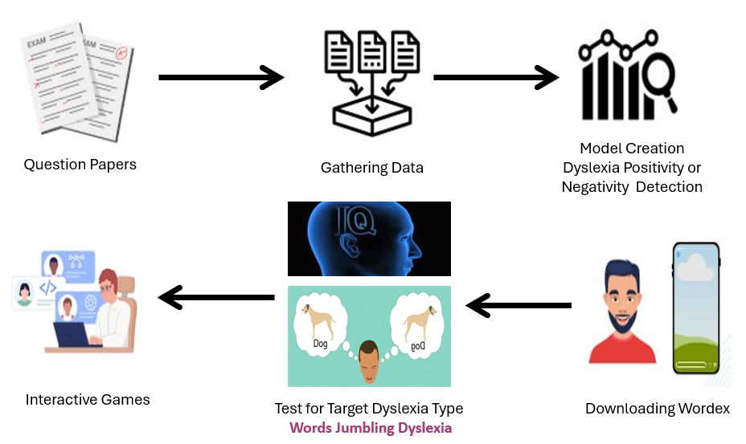
COMPONENT DIAGRAM

Slide 32

OBJECTIVES
Specific Objective
•Providing interactive exercises and games targeting Word Reading and Writing. Improve skills and confidence through engaging activities.
Sub Objectives
•Identification of Word Jumbling Dyslexia percentage among child
•Provide activities for identified children to reduce risk.
•Continuously track progress of children.
IT21345128 | Dissanayake D.M.O.W

Slide 33
FUNCTIONAL REQUIREMENTS
User Login
Take the Whole Word Jumbling Dyslexia identification test
View Test Results
Suggest Activities for condition improvement
IT21345128 | Dissanayake D.M.O.W

Slide 34
IMPLEMENTATION
Question Data
Student Assessment
API
Model Training
Model Training
Mobile Application
Output Prediction
Interactive Games

Slide 35
REFERENCES
C. Kariyawasam, M. Nadeeshani, T. Hamid, I. Subasinghe, and P. Ratnayake, "A Gamified Approach for Screening and Intervention of Dyslexia, Dysgraphia and Dyscalculia," presented at the 2019 International Conference on Advancements in Computing (ICAC), Malabe, Sri Lanka, Dec. 5-7, 2019. DOI: 10.1109/ICAC49085.2019.9103336.
A. Author, "ALEXZA: A Mobile Application For Dyslexics," vol. 10, no. 1, pp. 25-35, 2024.
B. Author, "Nana Shilpa - A Mobile-Based Screening and Refinement System to Identify the Risk of Dyslexia and Dysgraphia Learning Disabilities in Primary School Students," pp. 50-60, 2024.
Nessy Learning, "Nezzy Learning," [Online]. Available: https://www.nessy.com/en-gb. [Accessed: Aug. 5, 2024]. Available: Nessy Learning
C. Author, "A Gamified Approach for Screening and Intervention of Dyslexia, Dysgraphia and Dyscalculia," vol. 15, no. 3, pp. 100-110, 2024.
Tests for Dyslexia and Learning Disabilities | Dyslexia Help at the University of Michigan. Available: Dyslexia Help - University of Michigan
IT21345128 | Dissanayake D.M.O.W

Slide 36
IT21072888 SAMARAKOON S.M.S.C
BSc (Hons) Degree in Information Technology
Identify That Difficulty Spelling Words Dyslexia May Be Present And Provide Activities To Reduce The Risk.
IT21072888| Samarakoon S.M.S.C

Slide 37

BACKGROUND
Definition:
Spelling word dyslexia, also known as Dysorthographia, it is a condition characterized by persistent and significant difficulties in spelling, despite adequate instruction and intelligence.
Challenges:
Individuals often struggle with phonological and orthographic processes required for accurate spelling.
Impact:
This type of dyslexia can significantly affect a child's academic performance, and future opportunities if not addressed early and effectively.
IT21072888| Samarakoon S.M.S.C

Slide 38



RESEARCH QUESTION
How to develop a mobile application that helps for the students felts with difficulty spelling words?
How user attractive interfaces and activities can helps the children with difficulty spelling words?
How to improve the education of dyslexic children ?
IT21072888| Samarakoon S.M.S.C

Slide 39

OBJECTIVES
Specific Objective
To identify the risk of Spelling Words Dyslexia and develop the user attractive activities to enhance the condition of Spelling Words Dyslexia
Sub Objectives
Identification of children at risk of Spelling Words Dyslexia.
Develop interactive and engaging activities to improve spelling skills.

Slide 40
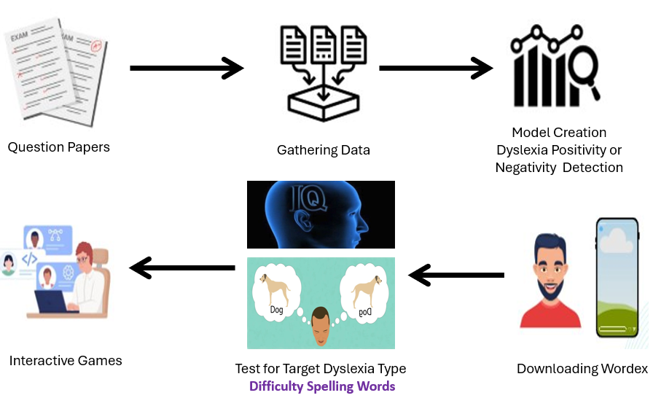
COMPONENT DIAGRAM

Slide 41

FUNCTIONAL REQUIREMENTS
Functional Requirements
Login to the system.
Attempts the quiz and identify the difficulty spelling word dyslexia
Provide the activities to overcome
IT21072888| Samarakoon S.M.S.C

Slide 42
IMPLEMENTATION
Question Data
Student Assessment
API
Model Training
Model Training
Mobile Application
Output Prediction
Interactive Games

Slide 43
REFERENCES
S. M. N. Senanayake, H. A. T. K. Karunaratne, and R. M. C. Ratnayake, "Arunalu: Learning Ecosystem to Overcome Sinhala Reading Weakness Due to Dyslexia," [Online]. Available: https://www.researchgate.net/publication/347357700_Arunalu_Learning_Ecosystem_to_Overcome_Sinhala_Reading_Weakness_Due_To_Dyslexia. [Accessed: Aug. 6, 2024].
J. K. Weerahewa, T. T. M. Jayasinghe, and A. T. K. K. De Silva, "Analysis of Spelling Errors from the 'Dyslexic Sight Words' List," [Online]. Available: https://www.researchgate.net/publication/378578352_Analysis_of_spelling_errors_from_the_'dyslexic_sight_words'_list. [Accessed: Aug. 6, 2024].
A. P. Wijesinghe, K. A. P. Liyanage, and S. M. I. Perera, "Spelling in Adolescents With Dyslexia: Errors and Modes of Assessment," [Online]. Available: https://www.researchgate.net/publication/233976504_Spelling_in_Adolescents_With_Dyslexia_Errors_and_Modes_of_Assessment. [Accessed: Aug. 6, 2024].
M. K. Dissanayake, R. M. C. Ratnayake, and H. A. T. K. Karunaratne, "Screening, Assessment, and Identification Tools for Dyslexia," [Online]. Available: https://www.researchgate.net/publication/376053102_Screening_Assessment_and_Identification_Tools_for_Dyslexia. [Accessed: Aug. 6, 2024].
IT21072888| Samarakoon S.M.S.C

Slide 44
IT21291746 MADUSHAN J.G.N
BSc (Hons) Degree in Information Technology
Identify That Read Aloud Confusion Dyslexia May Be Present And Provide Activities To Reduce The Risk.
IT21291746 | Madushan J.G.N

Slide 45

BACKGROUND
Definition:
Read Aloud Confusion Dyslexia is characterized by difficulties in reading text aloud accurately and fluently. Individuals with this form of dyslexia often make frequent errors, hesitate, and lose their place while reading aloud.
Challanges:
These difficulties can significantly impact reading comprehension and overall academic performance. Students with Read Aloud Confusion Dyslexia may struggle to keep up with classroom activities that involve reading aloud.
Impact:
Early detection and targeted intervention are crucial for helping individuals improve their reading skills.Effective support can enhance reading fluency and comprehension, leading to better academic outcomes.
IT21291746 | Madushan J.G.N

Slide 46
RESEARCH QUESTION
How can we tell if someone might have read aloud confusion dyslexia?
How can we keep track of someone's progress as they work on improving?
Can technology make it easier to identify and help people with read aloud confusion dyslexia?
What fun activities can we use to help improve this condition?
IT21291746 | Madushan J.G.N

Slide 47
OBJECTIVES
Specific Objective
To systematically identify the risk factors associated with read aloud confusion dyslexia and develop effective activities to enhance the condition.
Sub Objectives
Identification of Verbal Dyslexia
Identification of readaloud Dyslexia
Suggest remedies for identified users at risk
IT21291746 | Madushan J.G.N

Slide 48
IMPLEMENTATION
Question Data
Student Assessment
API
Model Training
Model Training
Mobile Application
Output Prediction
Interactive Games

Slide 49
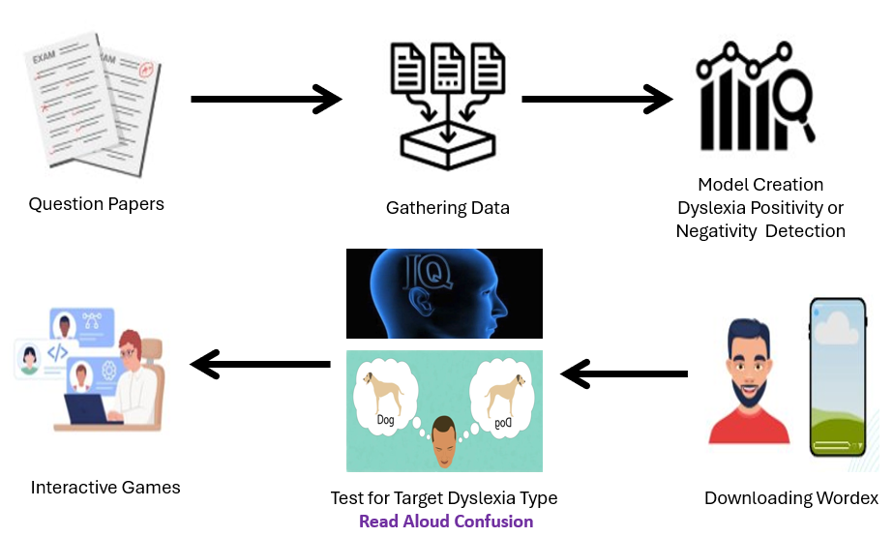
COMPONENT DIAGRAM

Slide 50
COMPONENT REQUIREMENTS
Functional Requirements
Voice Input Recognition.
Progress Tracking.
Personalized Learning Plan.
User Registration and Profile Management.
Playback of Recorded Voice.
IT21291746 | Madushan J.G.N

Slide 51
REFERENCES
[1] R. Rohizan, L. Hean Soon, and S. A. Mubin, "MathFun: A Mobile App For Dyscalculia Children," Journal of Physics: Conference Series, vol. 1712, 2020. doi:10.1088/1742-6596/1712/1/012030.
[2] S. Rajapakse, D. Polwattage, U. Guruge, I. Jayathilaka, T. Edirisinghe, and S. Thelijjagoda, "ALEXZA: A Mobile Application For Dyslexics Utilizing Artificial Intelligence And Machine Learning Concepts," 2018 IEEE 6th International Conference on Information and Communication Technology (ICoICT), 2018, pp. 318-323. doi:10.1109/ICoICT.2018.8528720.
[3] M. Chandrasiri, D. Hewathudalla, P. Ranasinghe, I. Wickramanayake, and S. Thelijjagoda, "The Hope: An Interactive Mobile Solution to Overcome the Writing, Reading, and Speaking Weaknesses of Dyslexia," 2019 14th International Conference on Computer Science & Education (ICCSE), 2019, pp. 808-813. doi:10.1109/ICCSE.2019.8845543.
[4] P. Deepa, M. Rajarathnam, and R. Priya, "Mobile Applications, An Emerging Powerful Tool for Dyslexia Screening and Intervention: A Systematic Literature Review," 2018 2nd International Conference on Inventive Systems and Control (ICISC), 2018, pp. 636-640. doi:10.1109/ICISC.2018.8398987.
[5] N. Kumar, V. Gupta, and A. Sharma, "A Gamified Approach for Screening and Intervention of Dyslexia, Dysgraphia, and Dyscalculia," 2018 IEEE 10th International Conference on Technology for Education (T4E), 2018, pp. 1-6. doi:10.1109/T4E.2018.8854951.
[6] M. Herath, S. Wijesuriya, A. Wijesinghe, and S. Thelijjagoda, "A Mobile App to Support People with Dyslexia and Dysgraphia," 2018 IEEE International Conference on Teaching, Assessment, and Learning for Engineering (TALE), 2018, pp. 960-965. doi:10.1109/TALE.2018.8615158.
IT21291746 | Madushan J.G.N

Slide 52
PROJECT ACHEIVEMENTS
Successful Implementation of the Wordex Mobile App
Completed model creation with 97.62% accuracy.
Completed UI design
Successful collaboration with Educational and Medical experts
IT21291746 | Madushan J.G.N

Slide 53

COMMERCIALIZATION
Speaking, Writing, Understanding is an important skills needed in life, many teachers and doctors in the schools we visited highlighted that it is important to support students with Dyslexia.
With sufficient personalized help and early detection, the condition can be significantly improved.

Slide 54
COMMERCIALIZATION CONT.
Subscription Plans For Wordex :
For Public schools
Rs. 2000
For International schools
Rs. 10,000
Annual Subscription (for individual student)
Rs. 2500
Monthly Subscription (for individual student)
Rs. 500
Low Income Familie

Slide 55
BUDGET
Component | Amount (USD) | Amount (LKR)
Traveling fee Doctor consultation. Data set gathering. | 17.60 | 5500.00
Internet charges Development. Technical Information Learning. | 6.40 | 2000.00
Online resources and Subscriptions APIs. Cloud services. Databases. | 48.00 | 15000.00
Total | 72.00 | 22500.00

Slide 56



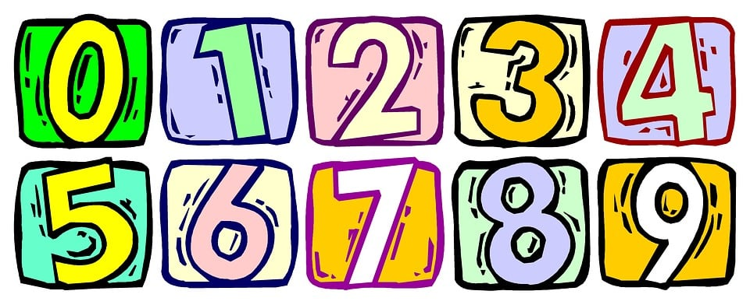
Future Work
Multi-Language Support
New Subtypes of Dyslexia Ex- Dyscalculia

Slide 57
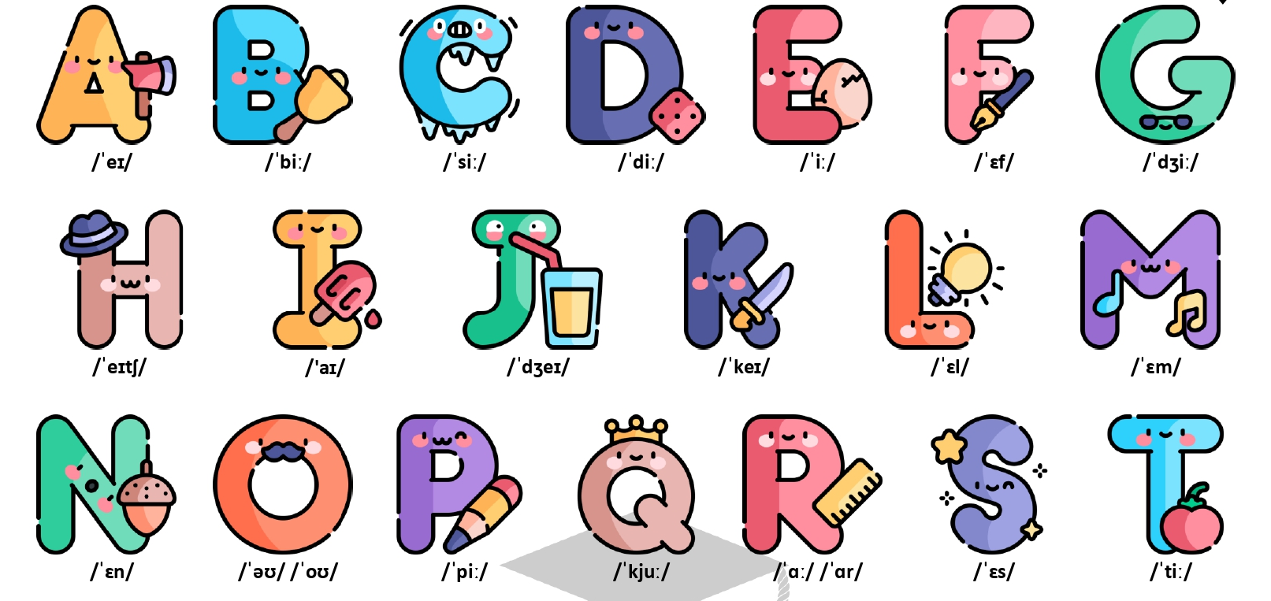
Thank You

Slide 58
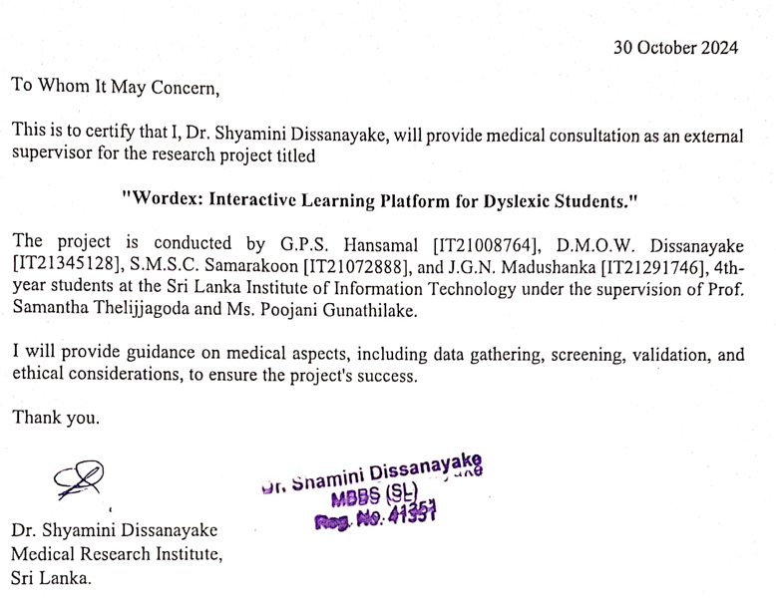
APPENDIX

